Slide 1

REACT; NOW
BY:
TEAM AJAX

Slide 2


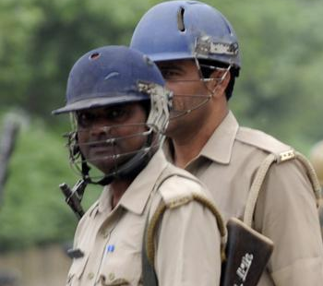
Problem Statement
Considering the ever-rising increase of issues on women harassment in recent past women security is one of the major concerns of today's world. The hack is to build a security system that is designed to serve the purpose of providing security to women so that they never feel helpless while facing such social challenges. An advanced system is to be built that can detect the location and health condition of a person that will enable us to take action accordingly.
Our Solution/Approach to The Problem
We plan to make a device that can actually help avoid rape/assault on women instead of just simply sending as SOS call after the crimes have happened.
In a comprisable
REACT;NOW
is a hybrid safety device equipped with an array of
FEATURES
Pepper spray and
stun gun
Give woman some time
Has Camera module
Camera sends
Escalates
Circumstance
Picture to server
Issue to
Woman in Distress
Family gets Access to pics
Police

Slide 3
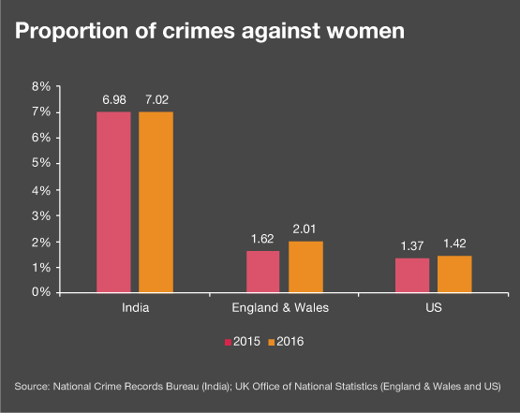
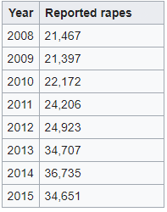
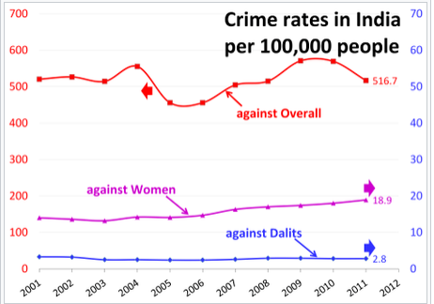
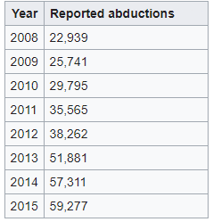
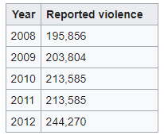
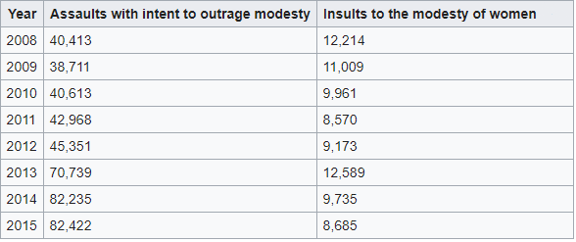
CRIME STATISTICS IN INDIA
CRIME RATE COMPARISON
RAPES
WOMEN ABDUCTION
CRIMES REPORTED AGAISNT WOMEN
INSULT TO MODESTY/ASSAULT
THIS, UNIMAGINABLY HIGH VOLUME OF CRIMES IS WHAT MOTIVATED US TO COME UP WITH A SOLUTION
INSULT TO MODESTY IS ONE OF THE MOST PROMINENT CRIMES AGAINST WOMEN
THERE HAS BEEN AN ALARMING RISE IN THE NUMBER OF RAPES THROUGHOUT THE COUNTRY
THOUGH LOOKED OVER, ABDUCTION IS ALSO A VERY COMMON CRIME THAT NEEDS TO BE REDUCED

Slide 4



Pictorial Demonstration
1st Line of Defense
Preferred for eve teasers or public stalkers
1st Line of Defense
A loud siren being used at a set frequency to catch the assailant off guard
Near and Dear of the Affected
If situation escalates
Woman
Insult to Modesty/Attempt to Rape
2nd Line of Defense
Uses our Product
A combination of pepper spray and gps enabled camera system. That will give women time to ward of the assailant and provide proof of crime
UPLOADS IMAGE AND LOCATION ON GOOGLE CLOUD
WILL CONTACT
Feels Threatened
Escalation to physical violence
To Send image
Assailant Approaching
3rd Line of Defense
Assault
A High Voltage low Amp Stun Gun to immobilize the assailant to suppress violent behavior
Police stations in vicinity of the crime

Slide 5
COST OF PROJECT VS BULK PURCHASE COST
Sno | Equipment | Cost(inr)
1 | Microcontroller | 1000
2 | Sim Module | 500
3 | Camera | 400
4 | Pepper Spray | 500
5 | Stun Gun Apparatus | 200
 | TOTAL | 2600/-
Sno | Equipment | Cost(inr)
1 | Microcontroller | 300/per 100 pc.
2 | Sim Module | 215-240/per 100 pc
3 | Camera | 120-150/per 1000 pc
4 | Pepper Spray | 45-70/per 1000 pc
5 | Stun Gun Apparatus | 75-100/per pc
 | TOTAL | 755-790/-
Our contraption if made wholesale components is already at a comparable price point to normal pepper spray. And Mass production will only further reduce the cost.

Slide 6
THANK YOU
TEAM AJAX
-Yash Chauhan
-Rohan Mujoo
-Mahima Kothari

